Slide 1
Using the Harvard Referencing System
College of Health & Social Care
September 2010

Slide 2


Why do I need to reference?
Reading, understanding and correcting referencing the work of others in your assignments is important.
By correctly referencing you will:
  Protect yourself against accusations of plagiarism
  Demonstrate that you have read widely
  Show your understanding of a topic
  Support your arguments with published research
If you don’t reference correctly you may commit plagiarism, which is seen as academic misconduct and carries penalties.
  http://www.governance.salford.ac.uk/cms/resources/uploads/File/AQA/28_Policy_on_the_Conduct_of_Assessed_Work_(Academic_Good_Conduct).pdf

Slide 3

What should I reference?
Acknowledging the work of others in your assignments gives academic credibility to your work by allowing you to back up your arguments with published material.
You should reference anything you have taken from another work, whether you are paraphrasing, summarising or directly quoting.
Some things can be taken as common knowledge and do not therefore need to be backed up with a reference.

Slide 4

Taking notes
Taking clear notes during your reading will make referencing much easier and quicker.
Make a note of: author / title / date / publisher details and chapter details / page numbers if relevant.
If it is online, note the web address and the date and time you accessed it.
Make clear distinction between any direct quotes you write down and information written in your own words so you don’t accidently plagiarise when you come to write you assignment

Slide 5

Citing in your text
The first part of a Harvard reference is the in-text citation where you acknowledge the sources you read.
Use (author, date) and page numbers if applicable.
Consider the flow of your writing when choosing how to include the citation.

Slide 6
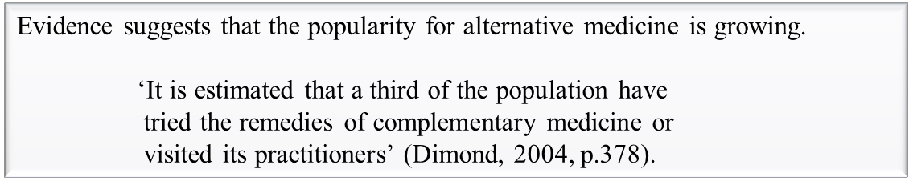
Quotations
Use quotation marks ‘t’ and page number(s) to indicate a direct quote.
Short quotes can be included in your own sentence:
Longer quotes should be indented and in a separate paragraph:
Avoid overusing quotations.

Slide 7
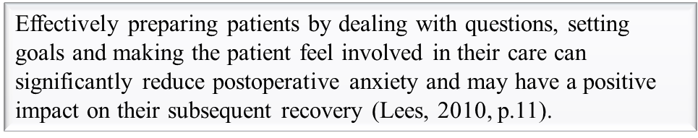
Paraphrasing
Presenting an idea or argument in your own words.
Ensure it is significantly altered from the original to avoid issues of plagiarism (just changing a couple of words is not enough!).
Paraphrases relate to specific sections of a work, so it is good practice to include the page number as you would do with a direct quotation.

Slide 8

Summarising
A brief outline of the main points of a work without going into specific details.
Generally summaries relate to a whole work, or to a large section, so are much less specific than paraphrasing.
As a summary potentially covers most or all of a work, it does not require page numbers to be given as they are for direct quotations and paraphrasing.

Slide 9
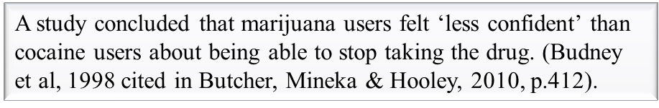

Secondary References
Where the passage you are referring to is the authors own reference to another work.
You are relying on their accurate and unbiased reproduction of that work, so it is much better to locate the source and read and reference it directly in you own work.
If you cannot locate the original, secondary reference it by:
In the body of your text cite both works
In your end list:
Reference the item you have read.

Slide 10
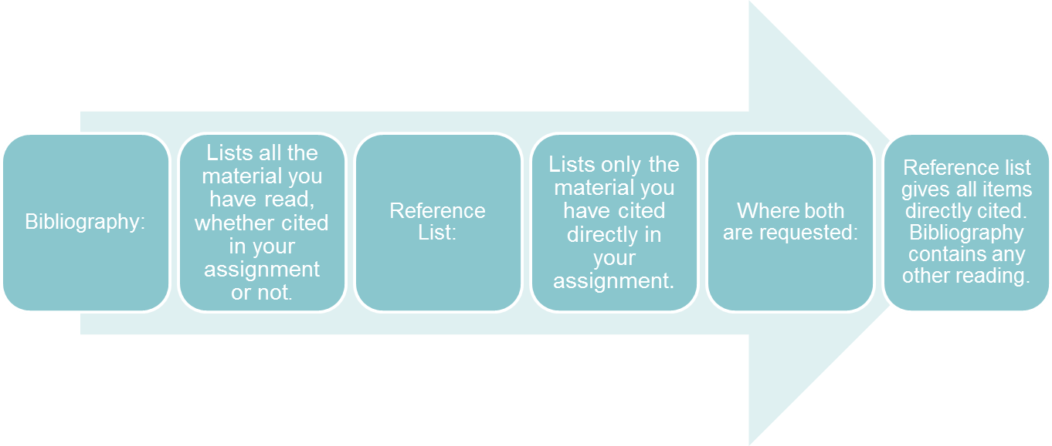
The End List
At the end of your work include a list of references.
List in alphabetical order by author, do not separate into different types of work.
The following slides show how to reference correctly.
    Always check your programme / module handbooks to see which form of end list is required.
Bibliographies and Reference Lists

Slide 11





How to reference a…
BOOK
Author(s)
Surname.Initial(s),
Use & between two authors.
Date
Year of publication
Title
In sentence case and italicised.
Publisher
Place of publication, publisher.

Slide 12






How to reference a…
e-BOOK
Date
Year of publication
Author(s)
Surname.Initial(s),
Use & between two authors.
Title
In sentence case and italicised.
Publisher
Publisher followed by [Online].
Access information
Give homepage of website, and date and time you accessed the resource.
(As e-books often require a login, only the homepage needs to be given.)

Slide 13





How to reference a…
JOURNAL ARTICLE
Date
Year of publication
Author(s)
Surname.Initial(s),
Use & between two authors.
Article Title
In sentence case
Journal Title
In Title Case and italicised
Journal information
Give volume and issue as x(x), followed by page numbers
pp. For multiple pages
p. For a single page item

Slide 14






How to reference a…
e-JOURNAL ARTICLE
Date
Year of publication
Author(s)
Surname.Initial(s),
Use & between two authors.
Article Title
In sentence case
Journal Title
In Title Case and italicised
Journal information
Give volume and issue as x(x), followed by page numbers
pp. For multiple pages
p. For a single page item
Follow with [Online].
Access information
Give homepage of website, and date and time you accessed the resource.
(As e-journals often require a login, only the homepage needs to be given.)

Slide 15





How to reference a…
WEB PAGE
Date
Year site last updated (often shown at the bottom of the page).
If not known, enter (no date).
Author(s)
Surname.Initial(s) if a person is the author. Otherwise use corporate author or organisation.
Page Title
In sentence case
Access information
Give full address of webpage, and date and time you accessed the resource.
Website Title
In Title Case and italicised. Followed by [Online].

Slide 16
How to reference …
Anything else…
http://www.resources.fhsc.salford.ac.uk/referencing/
Full referencing guide
Presentation
Help contacts

